Slide 1
SLAM continued

Slide 2
Plant Model
state; dimension 2n + 2
robot location
landmark 1 location
landmark 2 location
landmark n location

Slide 3
Plant Model
control input; dimension 2n + 2
robot step
*all zeros because no control is applied to landmarks

Slide 4
Plant Model
plant noise; dimension 2n + 2
noise in the control input (*additive)
*all zeros because landmarks are static

Slide 5
Plant Model

Slide 6
Measurement Model
the robot can measure all of the landmarks all of the time in a controlled order
the robot measures the relative offset from its position to each landmark
robot
landmark n
…
landmark 1
landmark 2

Slide 7
Measurement Model
dimension 2n
robot offset to landmark 1
robot offset to landmark 2
robot offset to landmark n

Slide 8
Measurement Model
dimension 2n

Slide 9
Measurement Model
measurement noise; dimension 2n
measurement noise for landmark 1 (*additive)
measurement noise for landmark 2 (*additive)
measurement noise for landmark n (*additive)

Slide 10
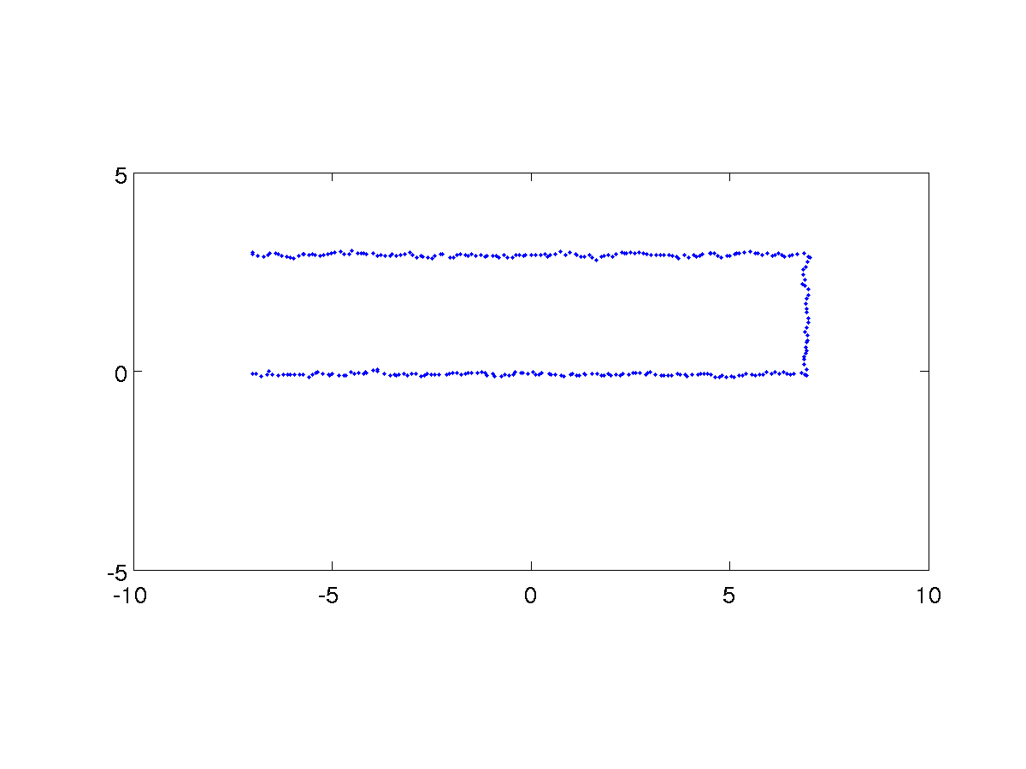
Example 1
estimated path

Slide 11
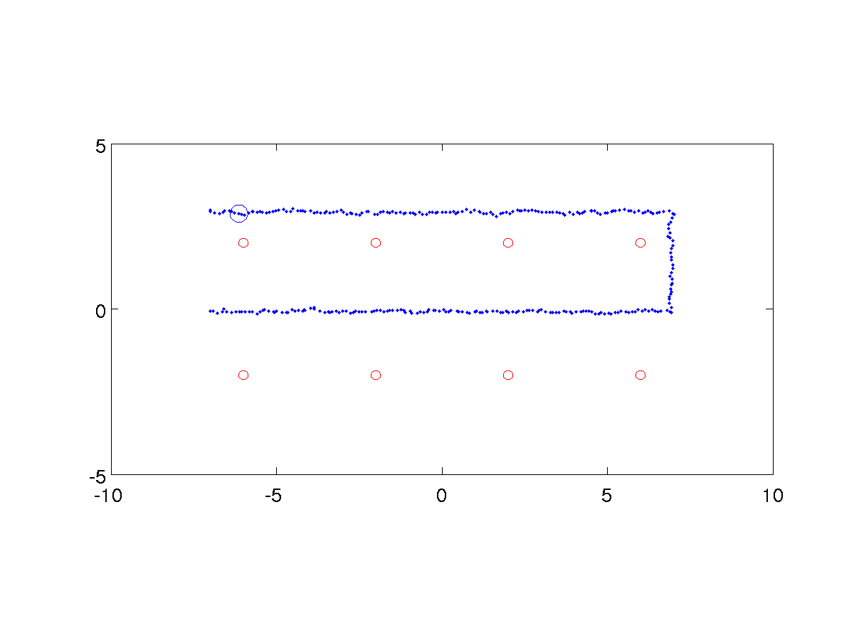
Example 1
robot position covariance
landmark position covariance
robot position covariance is small near the start point because the robot has not travelled far enough for the control input noise to accumulate

Slide 12
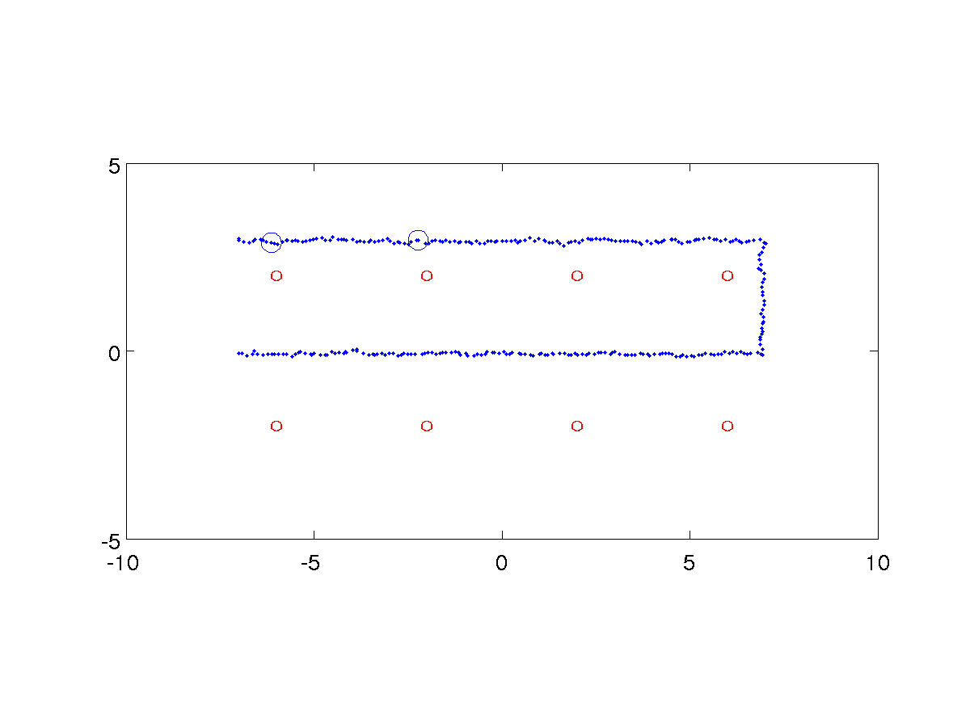
Example 1
robot position covariance
landmark position covariance

Slide 13
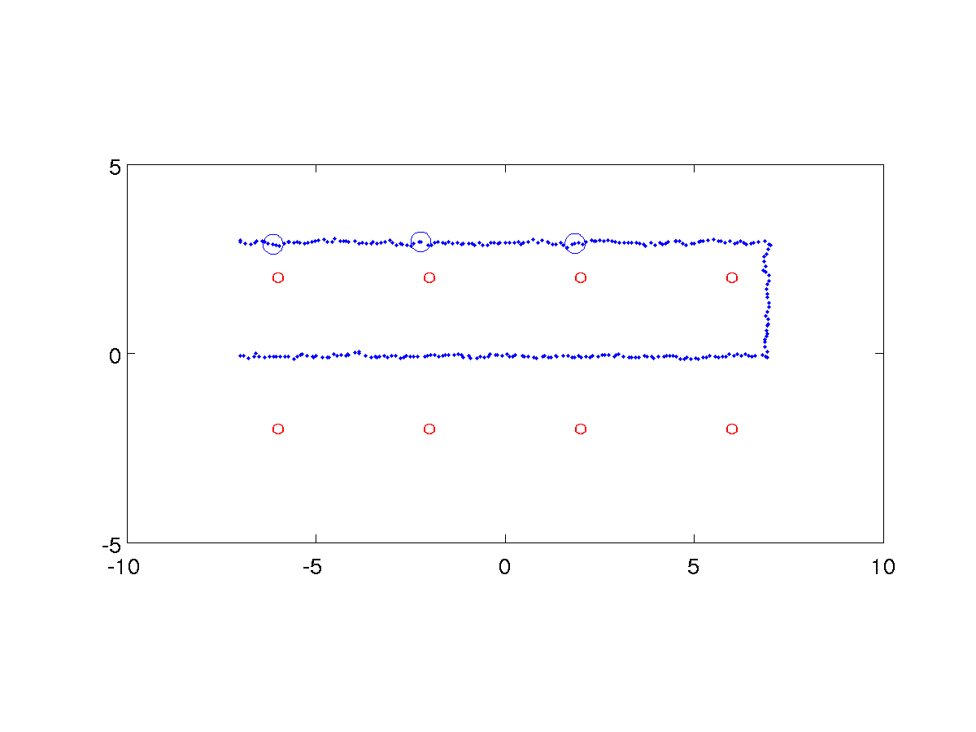
Example 1
robot position covariance
landmark position covariance

Slide 14
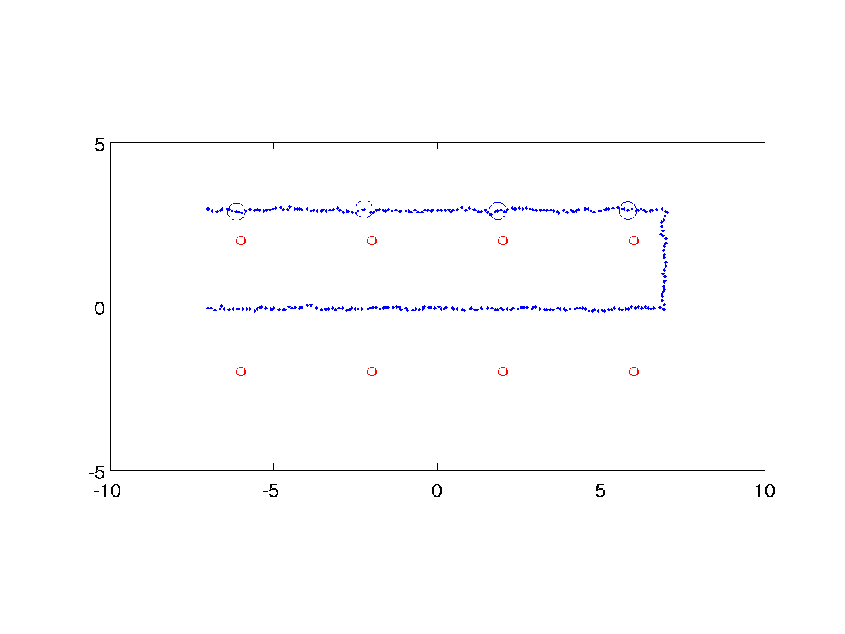
Example 1
robot position covariance
landmark position covariance

Slide 15
Example 1
robot position covariance
landmark position covariance

Slide 16
Example 1
robot position covariance
landmark position covariance

Slide 17
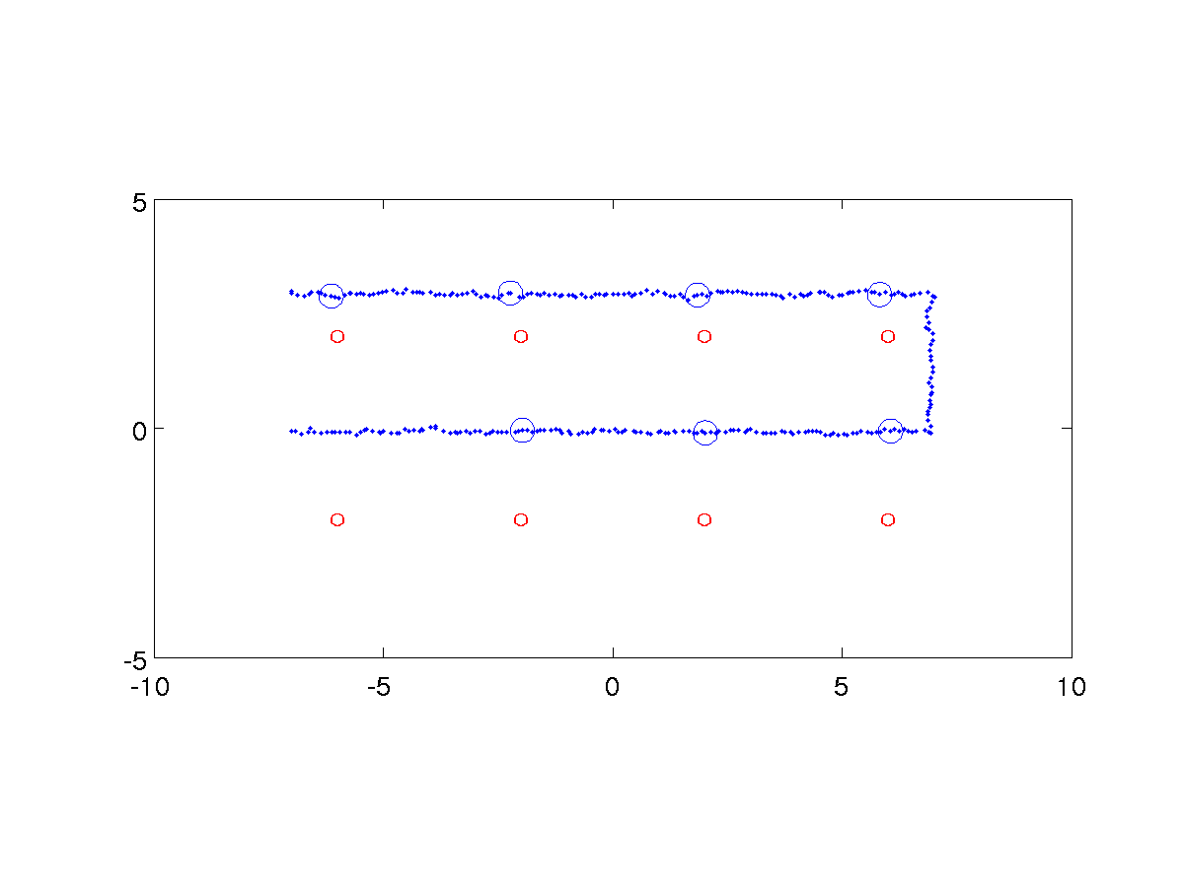
Example 1
robot position covariance
landmark position covariance

Slide 18
Example 1
robot position covariance
landmark position covariance

Slide 19
Example 2
the assumption that the robot can measure all of the landmarks all of the time is unrealistic for many kinds of sensors
what do we need to change if the robot can only sense a subset of the landmarks at any given time?
not the plant model

Slide 20
Measurement Model
the robot can measure all of the landmarks within a fixed radius around the robot
the robot measures the relative offset from its position to each landmark
robot
landmark n
…
landmark 1
landmark 2

Slide 21
Measurement Model
the robot might see multiple landmarks along sections of its path
landmark n
…
landmark 1
landmark 2

Slide 22
Measurement Model
the robot may not be able to measure any landmarks along sections of its path
landmark n
…
landmark 1
landmark 2

Slide 23
Measurement Model
the robot might revisit previously seen landmarks
landmark n
…
landmark 1
landmark 2

Slide 24
Measurement Model
assume that the actual sensor measurement for a landmark outside of the sensor range is [0 0]^{T}
then we need to change the measurement model so that we can “zero out” measurements to landmarks that are outside of the sensor range
this is easily done by manipulating Λ

Slide 25
Measurement Model
suppose that landmark 2 is outside of sensor range
zero out the rows corresponding to the measurement for landmark 2
Λ is now a function, Λ_{k} , of time

Slide 26
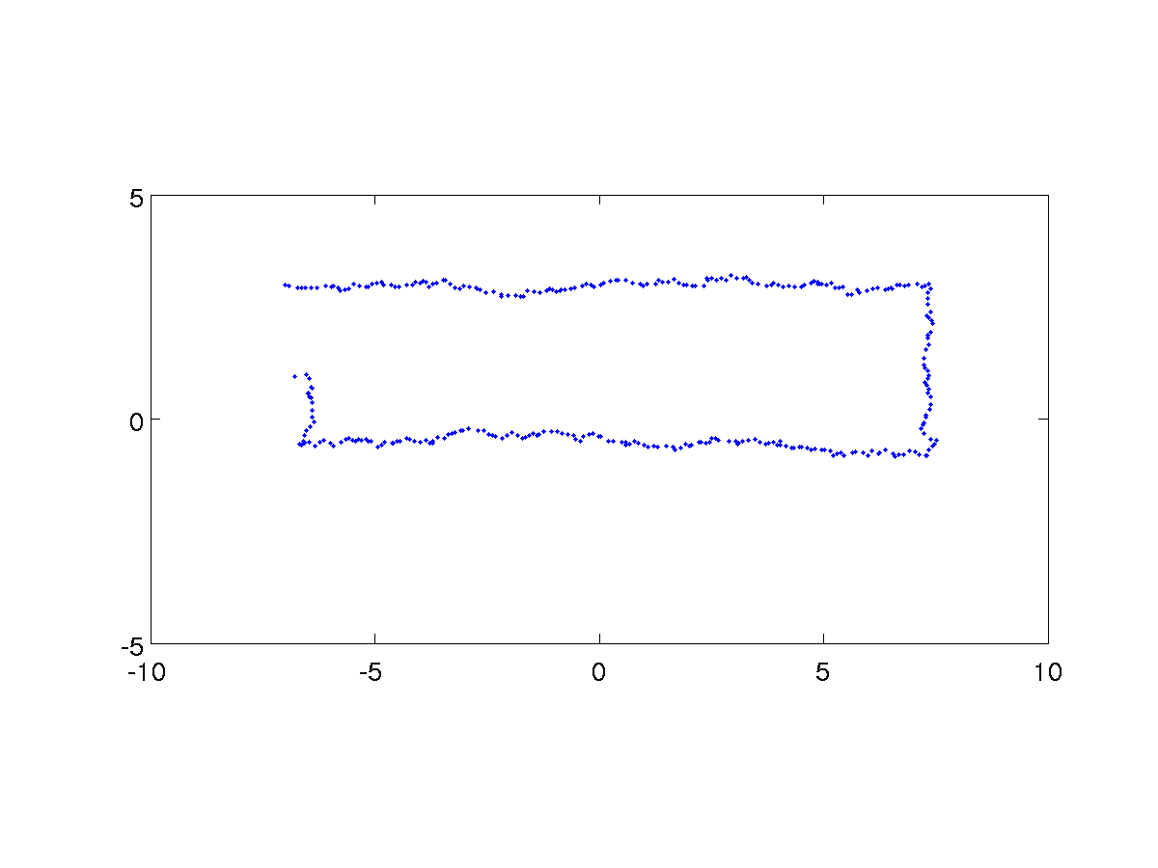
Example 2
estimated path

Slide 27
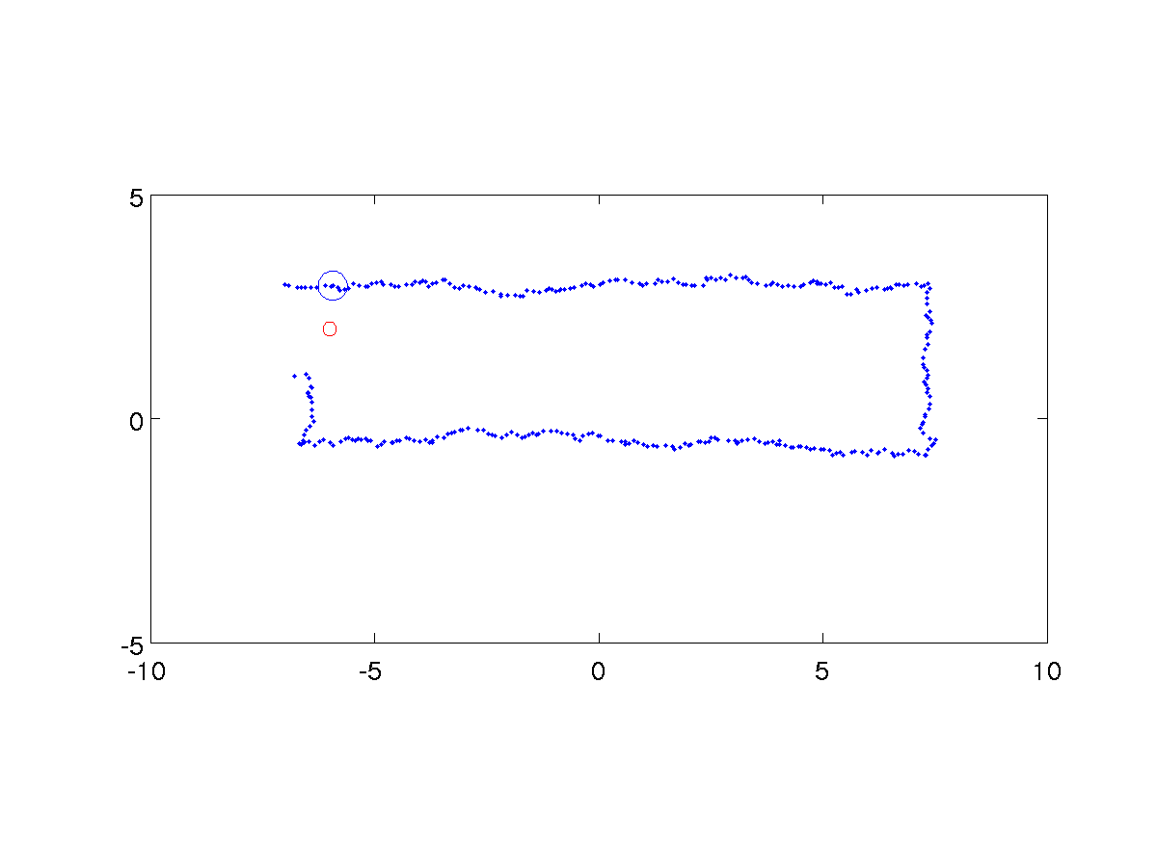
Example 2
robot position covariance
landmark position covariance

Slide 28
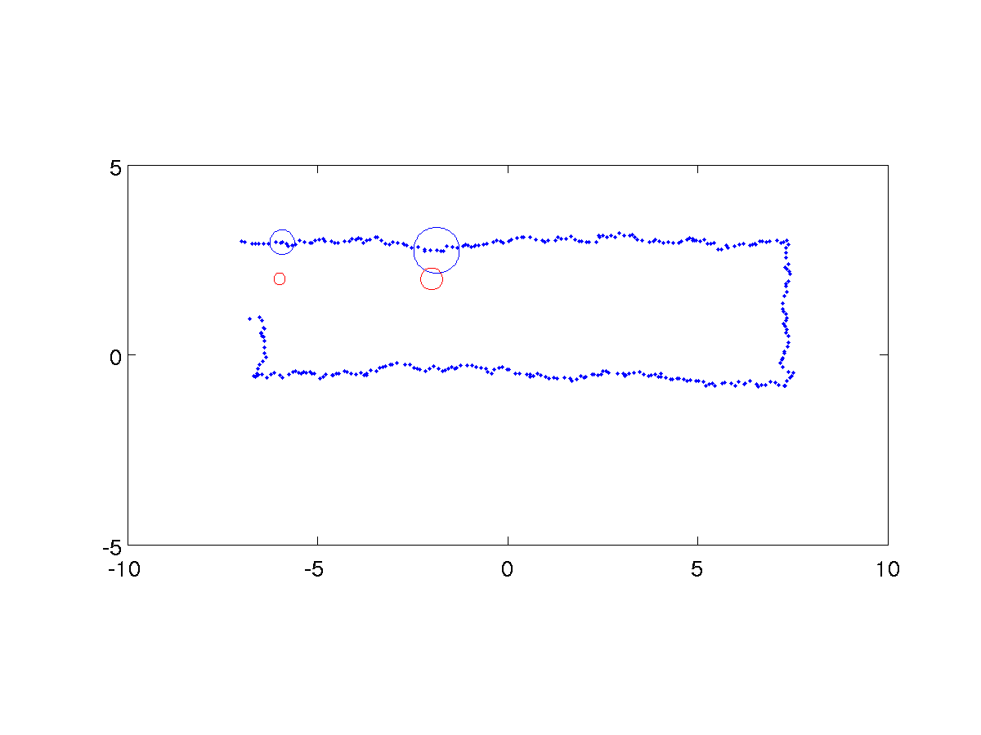
Example 2
robot position covariance
landmark position covariance
robot position covariance grows as control input noise accumulates (and cannot be completely corrected by observing one landmark at a time)

Slide 29
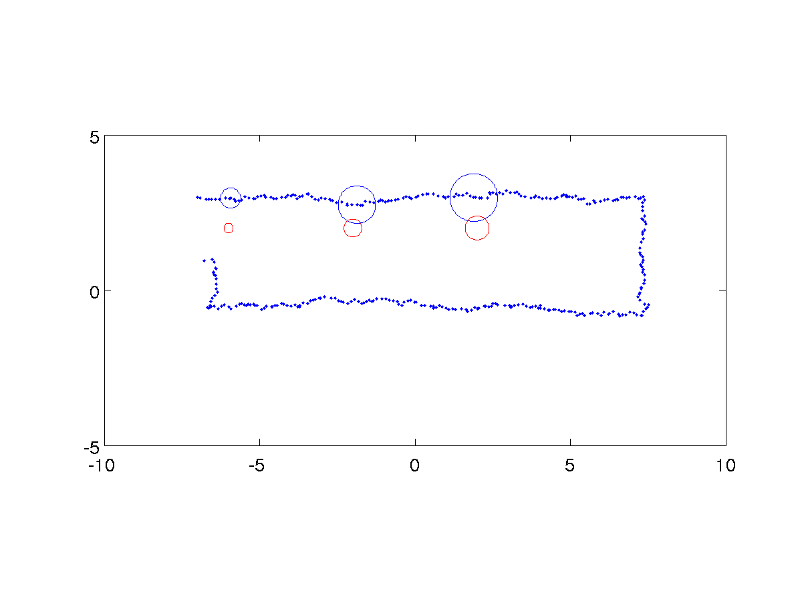
Example 2
robot position covariance
landmark position covariance
each subsequent landmark position covariance grows because the landmark position estimate is correlated with the robot’s position

Slide 30
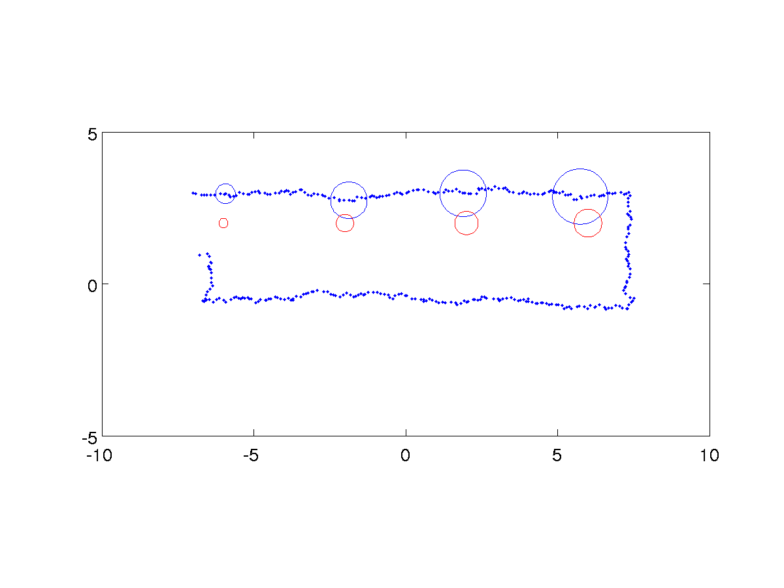
Example 2
robot position covariance
landmark position covariance

Slide 31
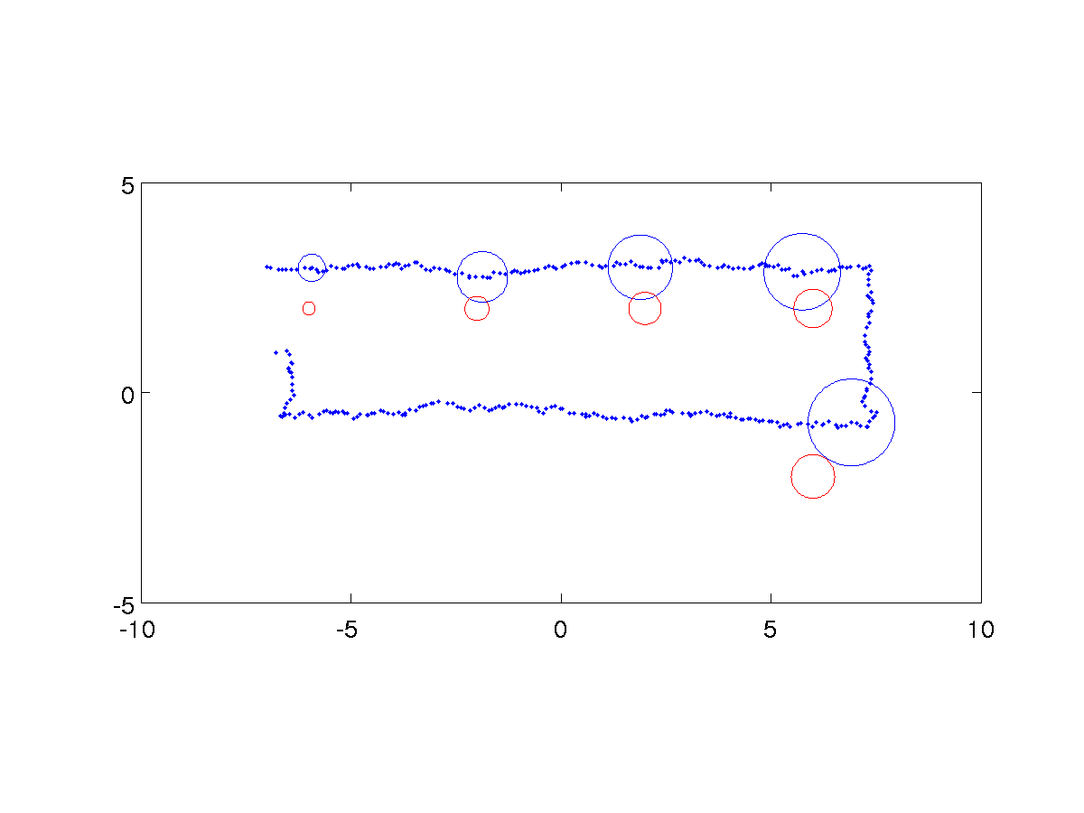
Example 2
robot position covariance
landmark position covariance

Slide 32
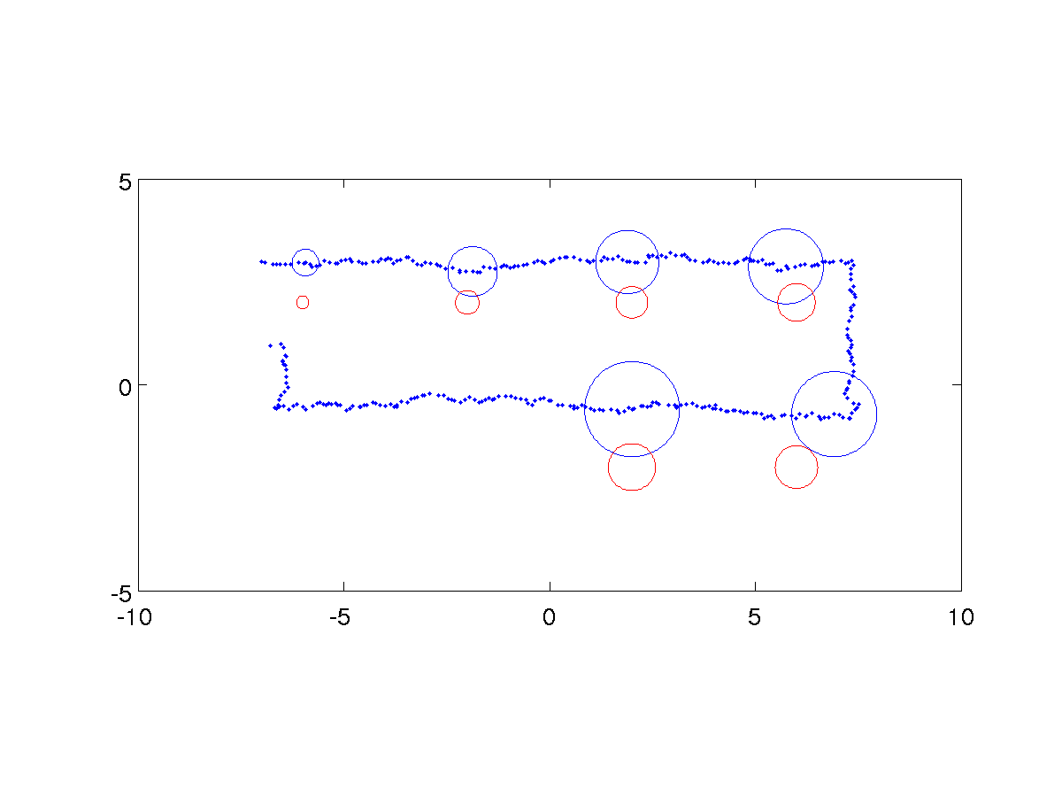
Example 2
robot position covariance
landmark position covariance

Slide 33
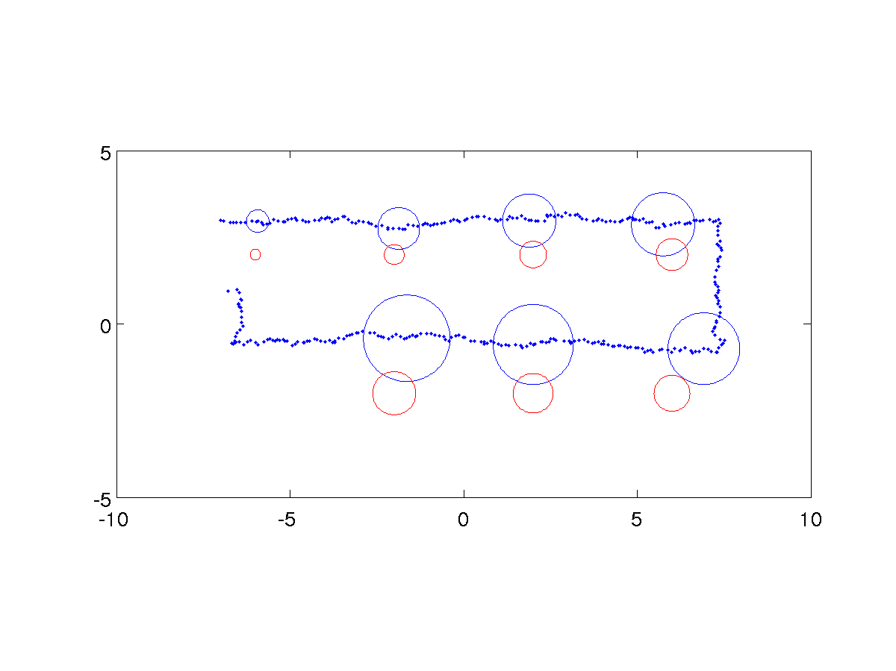
Example 2
robot position covariance
landmark position covariance

Slide 34
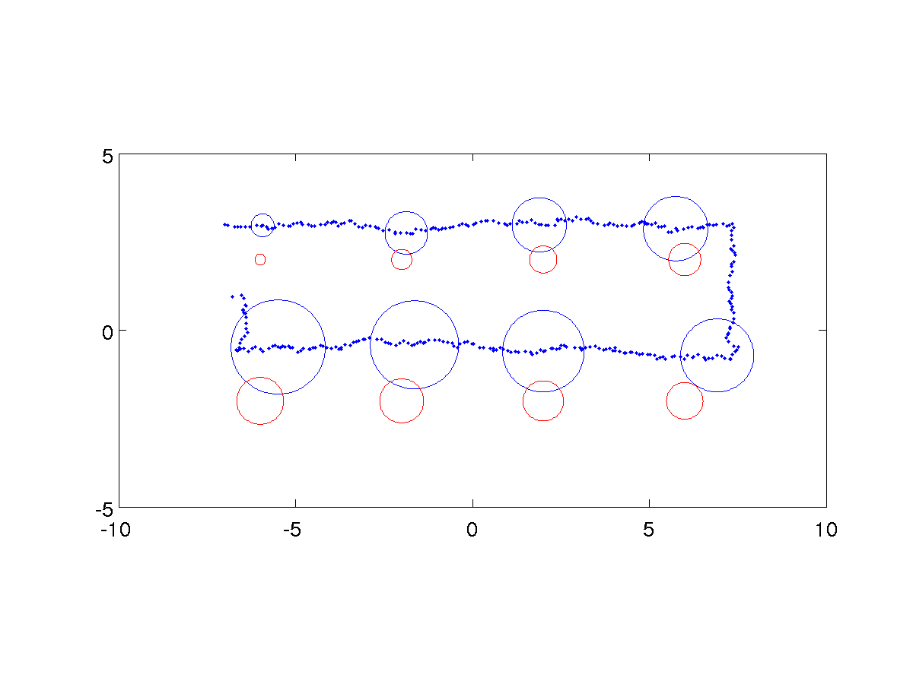
Example 2
robot position covariance
landmark position covariance

Slide 35
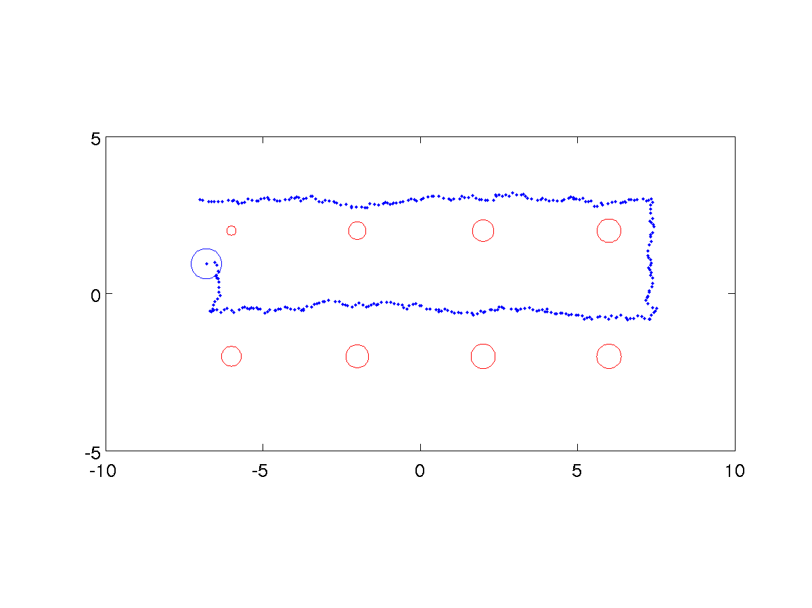
Example 2
robot position covariance
landmark position covariance
when the robot sees the first landmark for a second time all of the covariances decrease!

Slide 36
Loop Closure
the phenomenon illustrated on the previous slide is called “closing the loop”
occurs when a robot moving through unknown terrain encounters a landmark not seen for a “long” time
KF and EKF SLAM intrinsically perform loop closure (with high computational cost)
online demo http://rogerstuckey.com/simulation/javascript/slam-html5/
not every SLAM algorithm is capable of loop closure without an explicit loop closure process

Slide 37
Loop Closure in KF SLAM
it is not immediately obvious how KF SLAM performs loop closure until you look at the estimated state covariance matrix

Slide 38
Loop Closure in KF SLAM
notice how the covariance matrix is dense
the position of every landmark is positively correlated to the position of every other landmark (and the position of the robot)

Slide 39
Loop Closure in KF SLAM
loop closure in KF SLAM comes with a high computational and storage cost
state covariance matrix size is O(N ²) for N landmarks
direct implementation of KF equations require matrix multiplication and inversion
theoretical complexity O(N ^{2.376}), O(N ³) in practice
if the robot only observes a small number of landmarks then it is possible to perform an update in O(N ²)

Slide 40
KF SLAM in Practice
most Kalman filter approaches are actually EKF SLAM
non-linear plant and measurement models
many other issues not described in class
dealing with gross errors in sensor data
feature extraction from sensor data
landmark correspondences (called the data association problem)
3D instead of 2D motion
landmark management
choice of landmarks
provisional landmarks
landmark existence probability
addition of new landmarks
removal of false landmarks

Slide 41
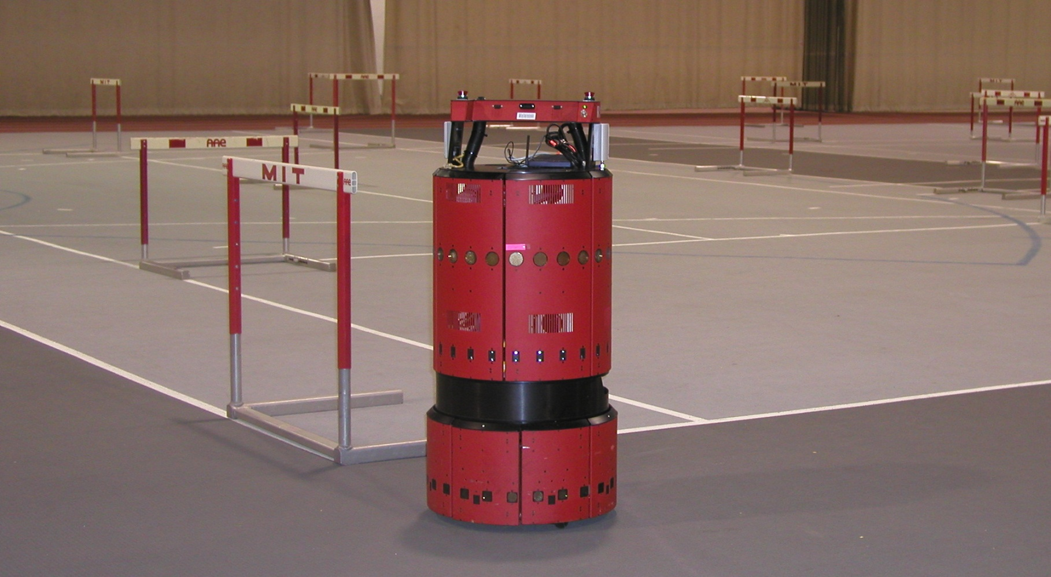
EKF SLAM Application
www.probabilistic-robotics.org
[MIT B21, courtesy by John Leonard]

Slide 42
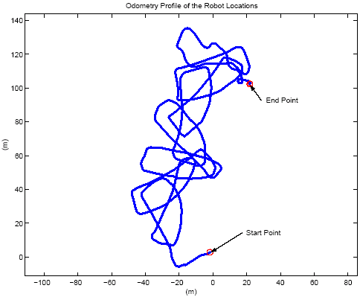
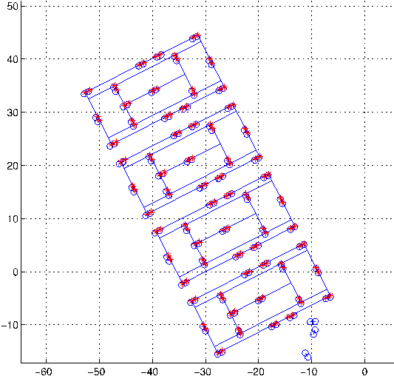
EKF SLAM Application
raw odometry
estimated trajectory
www.probabilistic-robotics.org
[courtesy by John Leonard]

Slide 43
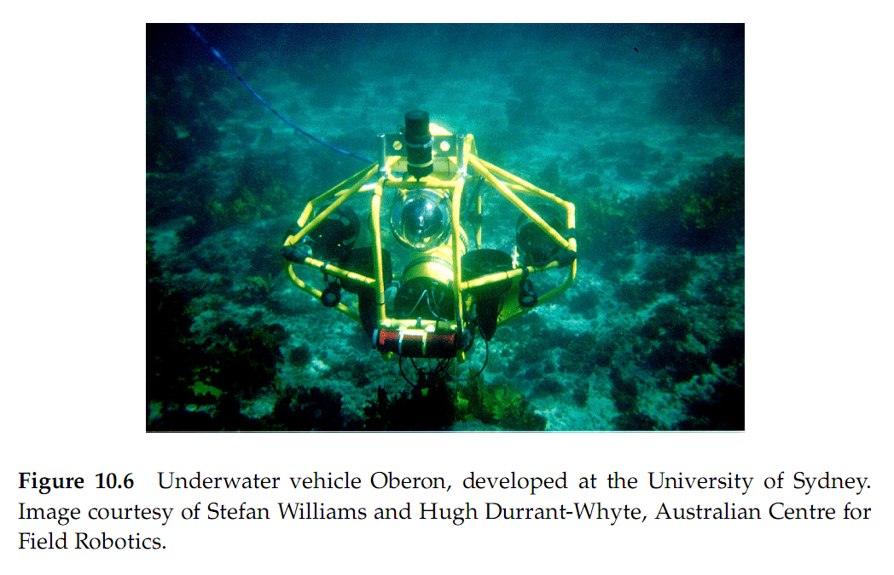
EKF SLAM Application

Slide 44
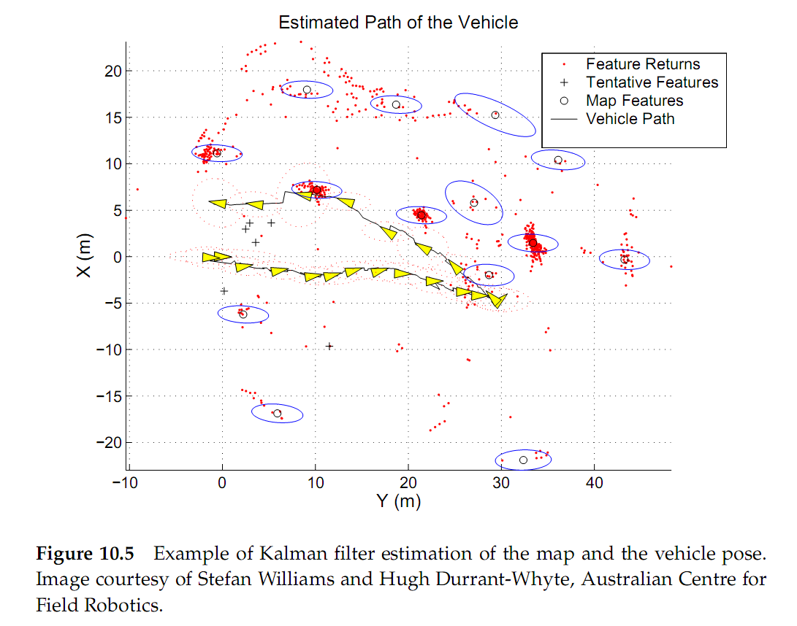
EKF SLAM Application

